Slide 1
Research Update
9th October

Slide 2
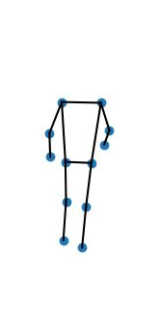
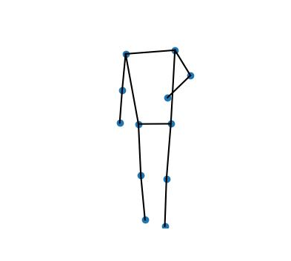
Tasks Completed
Changing the frame rate
  Every third frame was extracted from the video instead of every tenth.
Modified the segmentation technique
  First, each frame was extracted using the YOLOV8 model
  Then, each frame was centered so that when they were placed on top of each other, they would create an aligned energy image
  Finally, each image was scaled up.

Slide 3

Tasks to be done
Creation of energy image
  The keypoints need to be removed from the segmented images, only the connecting lines should remain
  The following is the technique used by Albuquerque et al.
We can give the first and last images more weight when combining them

